Slide 1


NEW YORK CITY-AIRBNB REPORT
-Submitted by
Abhishek De
Rahul Roy

Slide 2

Agenda
Objective
Host Acquisition and Locality
Neighborhood we can target
Pricing ranges
How price affects various localities
Properties preferred by customers
Holding types across various locations

Slide 3
Objective
Improve our shared understanding about the market conditions.
Improve shared understanding about our customers.
Provide recommendations to various departments to be prepared for business expansion.

Slide 4
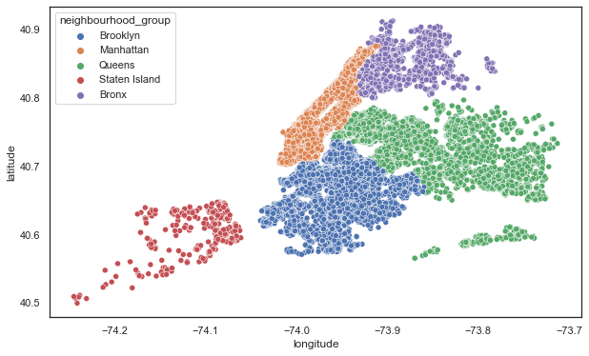
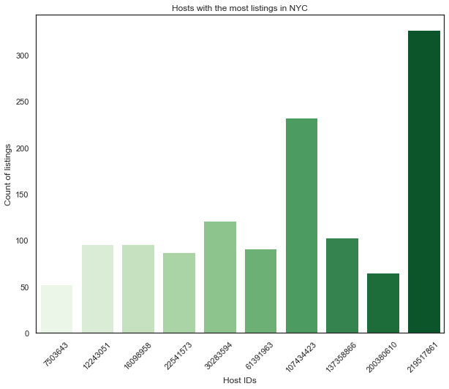
Host Acquisition and Locality
As per our analysis,we infer that Host id:219517861 and Host id:107434423 are having most properties in Manhattan,so we can try to acquire more properties there.

Slide 5
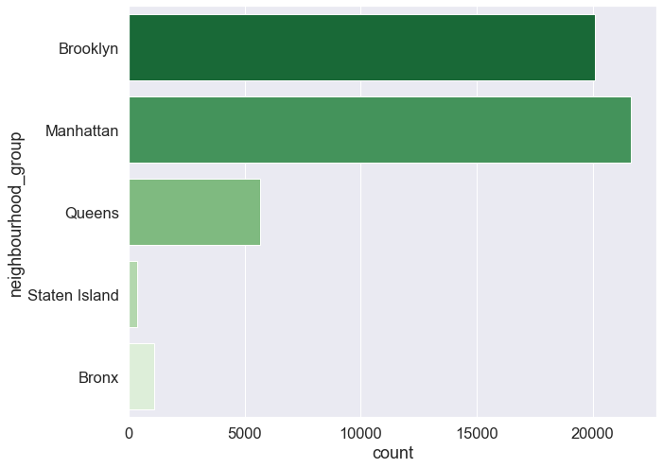
Neighborhood we can target
We infer from the scatter plot that Manhattan is not the largest parts of New York by area but it has the highest number of Airbnb holdings suggesting that it is a popular tourist place and has huge number of visitors round the year. So directors can try to acquire properties .

Slide 6
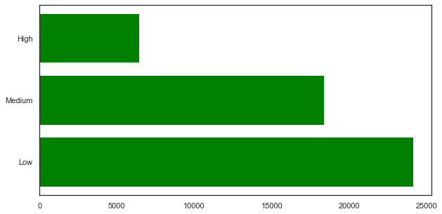
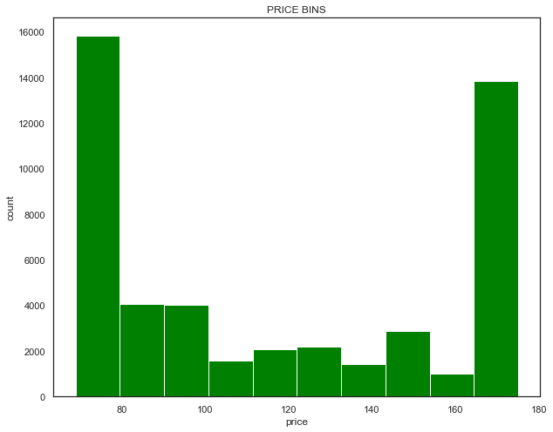
Pricing ranges
Here are the price ranges: $(70-105) comprises of Lower Pricing Range,$(105-140) comprises of Medium Pricing Range and above $140 comprise the higher pricing ranges.
Customers prefer lower price rooms over any other pricing ranges.

Slide 7
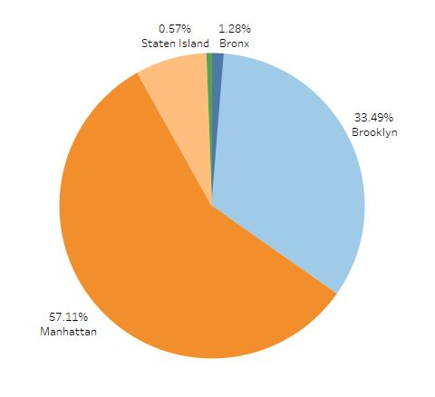
How price affects various localities
From our analysis we presented the price changes across various parts of New York city for AirBnb holdings.

Slide 8
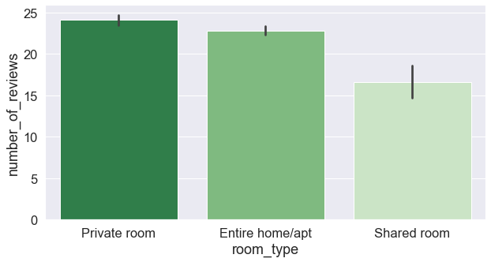
Properties preferred by customers
We infer from the above charts that customers mostly prefers Private rooms over Entire home and Shared room.

Slide 9
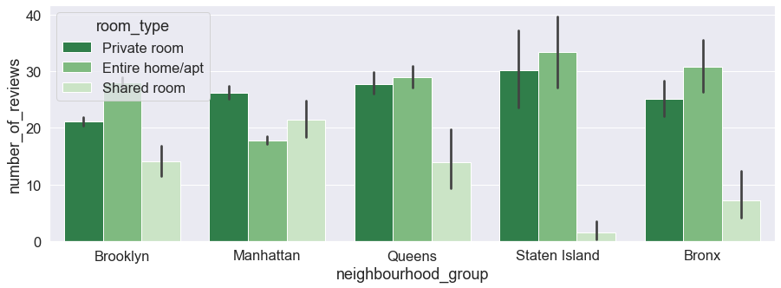
Holding types across various locations
As per our analysis,these are various Airbnb holdings across various parts of New York city based on customer preferences.

Slide 10
Recommendations
We should try to acquire more properties in Manhattan.
From our analysis, customers prefer Private rooms with a lower price range($70-$105).
We should offer great discounts in Station Island as there are less bookings compare to other localities.

Slide 11
Thank You

